Slide 1
Vehicle Detection and Monitoring using Magnetic Field Sensors
Pradeep Kumar. N (1BG10EC058)
Nikunj. T (1BG10EC054)
Nafeeya Samar (1BG10EC047)
Noor Zahara (1BG10EC055)
Project Guide:
Anuradha V. Rao

Slide 2
Vehicle Detection and Monitoring using Magnetic Field Sensors
Motivation:
Alleviation of traffic congestion by improving the efficiency of the current transportation system.
Solution: Real-time traffic surveillance
Requirement: Acquisition of traffic metrics (speed, volume etc.) which can be obtained using Magnetic sensors and Induction loops.
Objectives:
Development of traffic monitoring system using low power, low cost magnetic sensors and induction loops.
The data acquired is used to increase the efficiency and to enhance the capacity of the existing roadways.

Slide 3
Vehicle Detection and Monitoring using Magnetic Field Sensors
Generic block diagram
Vehicle Movement
Sensors
(A or B)
Signal Processing System
Monitoring System
Database
GUI
A: Induction loop
B: AMR sensor

Slide 4
Vehicle Detection and Monitoring using Magnetic Field Sensors
Block Diagram of Induction Loop Detector
Presence of Vehicle
V_{ref}
Microcontroller
(ATmega2560)
Colpitt’s Oscillator
Change in Inductance of the loop
Change in magnetic field
Comparator
Frequency Counter
Computer
Database
GUI

Slide 5
Vehicle Detection and Monitoring using Magnetic Field Sensors
Flowchart for Induction Loop system
Start
Wait for vehicle to move over the loop
L = L-ΔL; f = f+Δf
Measure frequency of comparator output
Frequency change > threshold?
Increment count and store
(max count: 2³²)
Yes
UART send: Vehicle detected
No

Slide 6
Vehicle Detection and Monitoring using Magnetic Field Sensors
Circuit Diagram of Colpitt’s Oscillator and comparator
To μC

Slide 7
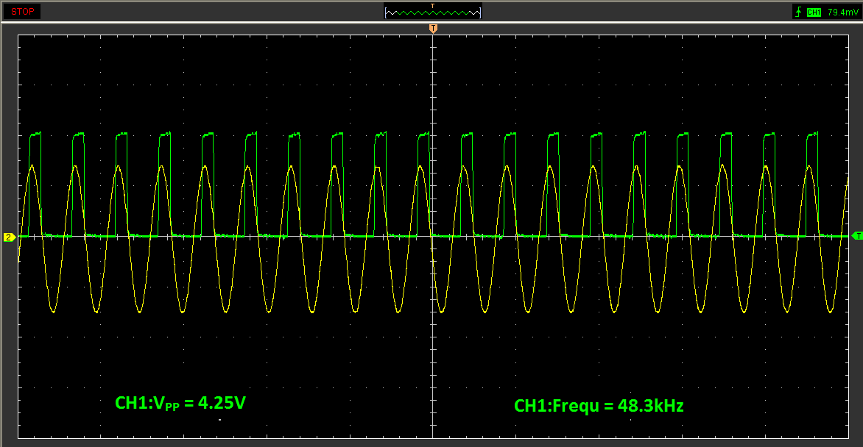
Vehicle Detection and Monitoring using Magnetic Field Sensors
Typical oscillator and comparator output

Slide 8


Vehicle Detection and Monitoring using Magnetic Field Sensors
Technical Specifications of Induction Loop detector
Induction Loop
#12 AWG wire
6 ft x 6 ft square loop
Length of lead-in cable = 2m
Inductance: 100µH
MC33274 Quad Op-Amp IC used to build oscillator (50KHz) and comparator (V_{cc} = 5V)
Microcontroller: ATmega2560 Arduino Board
8-Bit, AVR enhanced RISC architecture
256KBytes of In-System Self-Programmable Flash
4Kbytes EEPROM
8Kbytes Internal SRAM

Slide 9
Vehicle Detection and Monitoring using Magnetic Field Sensors
Block Diagram of AMR sensor Vehicle Detection System
Slave Module 1
Master Module
Transceiver
Microcontroller
(Jennic)
AMR sensor
Microcontroller
(Jennic)
Transceiver
Slave Module 2
Computer
AMR sensor
Microcontroller
(Jennic)
Database
GUI
Transceiver

Slide 10
Vehicle Detection and Monitoring using Magnetic Field Sensors
Flowchart for Slave Module
Start
Calibrate Sensor
Sensor output converted to digital value by ADC
Read ADC output
Is ADC value > detection threshold?
Yes
Radio Transmission: Vehicle detected
No

Slide 11
Vehicle Detection and Monitoring using Magnetic Field Sensors
Flowchart for Master Module
Start
Wait for Radio packet arrival from slaves 1 & 2
Radio packet pair Received?
No
Yes
UART send: Vehicle detected
Increment count and store
(max count: 2³²)
Calculate speed = dist/(t₂ – t₁)

Slide 12
Vehicle Detection and Monitoring using Magnetic Field Sensors
Technical Specifications of AMR sensor Vehicle Detection System
AMR sensor
Supply voltage: 3 - 5V
Sensitivity: 16 (mV/V)/(kA/m)
Total power dissipation: 130mW
Microcontroller: Jennic JN5148-001
Low power 32-bit RISC CPU, 4 to 32MHz clock speed
128kB ROM & 128kB RAM for boot loaded program code & data
4-input 12-bit ADC, 2 12-bit DACs, 2 comparators
2 UARTs

Slide 13
Vehicle Detection and Monitoring using Magnetic Field Sensors
Technical Specifications of AMR sensor Vehicle Detection System
Radio Transceiver
2.4GHz IEEE802.15.4 compliant
Typical data rate: 256kbps
500 & 667kbps High data rate modes
Receiver sensitivity -95dBm
Transmit power 2.5dBm

Slide 14
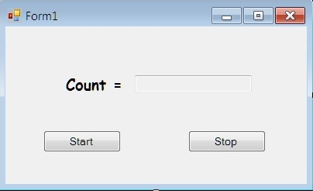
Vehicle Detection and Monitoring using Magnetic Field Sensors
Snapshot of GUI for Induction Loop detector

Slide 15
Vehicle Detection and Monitoring using Magnetic Field Sensors
Results for Induction Loop Detector
Dimensions | No. of turns | Center Frequency | Frequency drift
1.5ft x 1.5ft | 10 | 48.3 kHz | 500 Hz
6ft x 6ft | 2 | 80 kHz (Unstable) | Unreliable
6ft x 6ft | 3 | 51 kHz | 100 Hz
6ft x 6ft | 4 | 41 kHz | 30 Hz

Slide 16
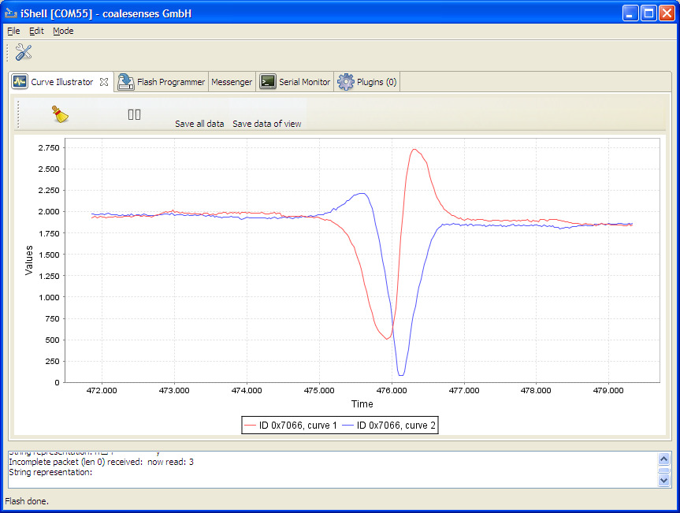
Vehicle Detection and Monitoring using Magnetic Field Sensors
Typical AMR sensor output

Slide 17
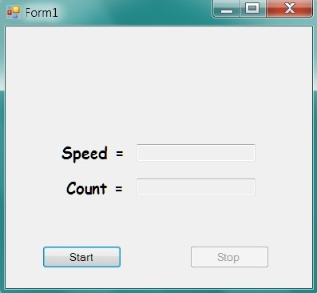
Vehicle Detection and Monitoring using Magnetic Field Sensors
Snapshot of GUI for AMR sensor Vehicle Detection System

Slide 18
Vehicle Detection and Monitoring using Magnetic Field Sensors
Proposed database format
Date | Vehicle count | Avg speed

Slide 19
Vehicle Detection and Monitoring using Magnetic Field Sensors
Completed tasks
Induction loop detector
Building and testing the circuit
Program for frequency measurement and vehicle count
AMR sensor Vehicle Detection System
Program for:
Time synchronization of the slave modules
Vehicle detection based on slope change
Speed calculation based on difference in times between packets from the two slaves

Slide 20
Vehicle Detection and Monitoring using Magnetic Field Sensors
Remaining tasks
Induction loop detector
Field tests to determine optimal area and no. of turns of the loop
Refining the program to reduce the probability of false counts
AMR sensor Vehicle Detection System
Refining the program to reduce the probability of false counts
Finding a solution for the problem of sensor output saturation
Field tests to determine the optimal sampling freq for the sensor

Slide 21
Vehicle Detection and Monitoring using Magnetic Field Sensors
References
[1] Ravneet Bajwa, Ram Rajagopal, Pravin Varaiya and Robert Kavaler. In-Pavement Wireless Sensor Network for Vehicle Classification.
[2] Sing Yiu Cheung, Sinem Coleri Ergen and Pravin Varaiya. Traffic Surveillance with Wireless Magnetic Sensors.
[3] Farshad Ahdi, Mehdi Kalantari Khandani, Masoud Hamedi, Ali Haghani.
Traffic data collection and anonymous vehicle detection using wireless sensor networks.
[4] Traffic Detector Handbook: Third Edition—Volume I. Publication No. FHWA-HRT-06-108.

Slide 22


